Slide 1
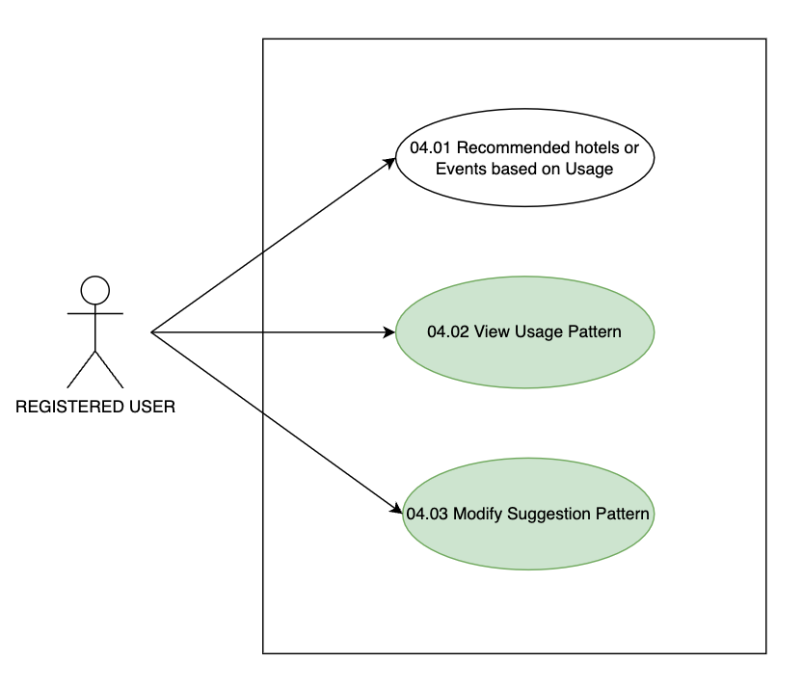
Use Case diagram related to module “04. Suggestions And Recommendations”

